Slide 1

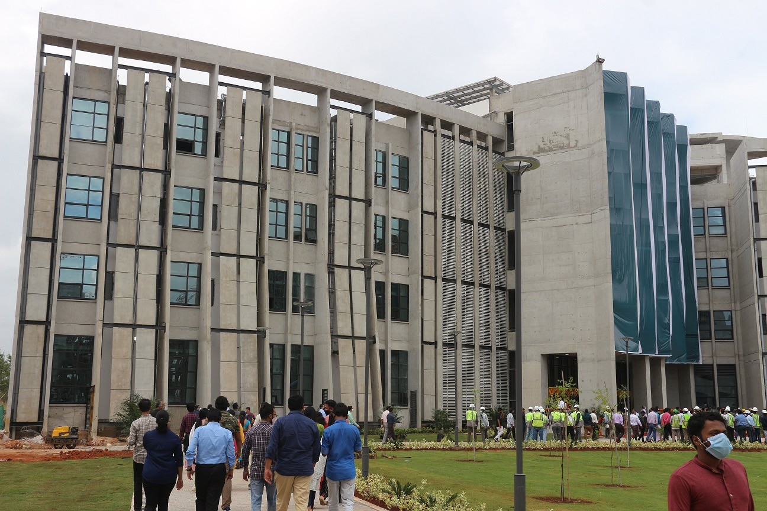
Department of
Biomedical
Engineering
Physiological monitoring using CCTV camera in ICU
Name: SANJEY V A
Roll no: Student Intern
11.07.2024
SANJEY VA
1

Slide 2
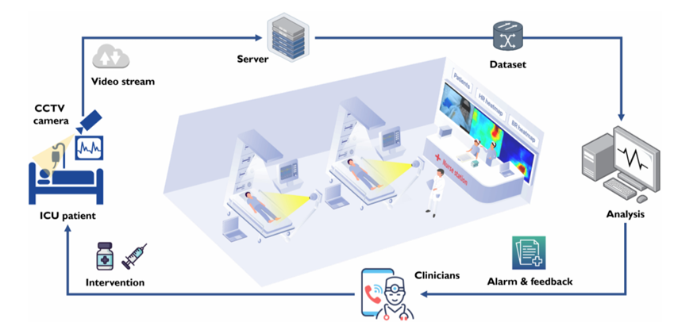
Introduction
The monitoring of vital signs is important for the intensive care unit(ICU) where patients are under serious condition.
The fundamental vital signs are Heart rate (HR) and breath rate (BR).
The HR and BR can also be monitored using contact-based monitoring, where multiple cables and sensors are attached to the patient which could cause infections and discomfort to the clinicians.
We can use contactless monitoring to overcome these disadvantages, by using CCTV camera for monitoring and measuring the vital signs.
Fig 1: Scheme of hospital IoT-based remote patient monitoring system

Slide 3
CLINICAL SETUP
The CCTV camera installed on the ceiling is approximately 3m in front of patient, the model of the camera is Panasonic WV-SC384H fast ball network camera, the camera has optical zoom capability of 18 times, with focal length range from 4.7 to 84.6mm
Video is recorded in RGB format at 25 frames per second(fps) with the resolution of 1080 x 1920 pixels and saved in MPEG-4 format on a central server
Patient monitor: Bene Vision N17 Patient monitor and pulse oximeter(PLINMA) for physiological reference
Lighting conditions: Indoor lights were always ON in the ICU during day and night time

Slide 4
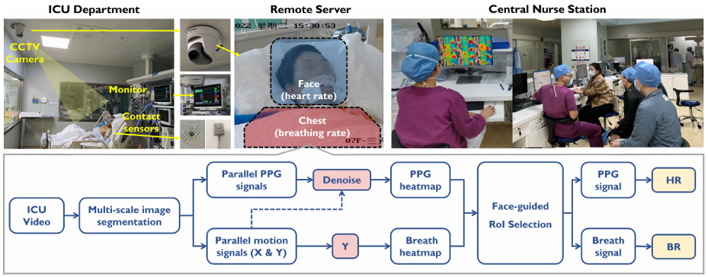
Methodology
Fig 2: ICU setup and methodology

Slide 5
Methodology
Image segmentation and processing
Extracting the frames from the RGB CCTV camera
Reduce image resolution by Binning process from 1080x1920 to 270x480 pixels,
which can reduce image sensor noise and quantization noise
The down sampled image is segmented into subregions of local blocks at 4 different scales 28x28,48x48,70x70,100x100 pixels
The stride of each scale is half of the block size, which does overlap-block-based dense segmentation.

Slide 6
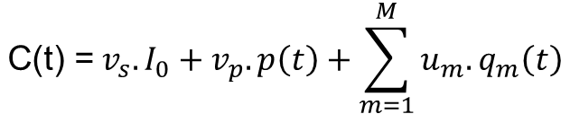
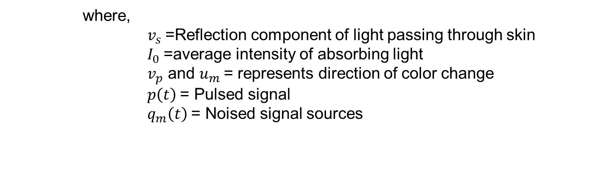
Methodology
Camera based PPG extraction:
Input
The optical skin reflection signals captured by an RGB camera is denoted as C(t),
$$\text{C}\text{(}\text{t}\text{) =}{ v}_{s}.I_{0}+v_{p}.p\left(t\right)+\sum_{m=1}^{M}{u_{m}.q_{m}\left(t\right)}$$
where,
${ v}_{s}$=Reflection component of light passing through skin
${ I}_{0}$=average intensity of absorbing light
${ v}_{p}$ and $u_{m}$= represents direction of color change
$p\left(t\right)$= Pulsed signal
${ q}_{m}\left(t\right)$= Noised signal sources

Slide 7
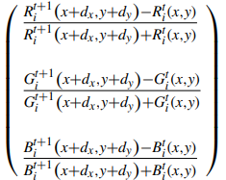
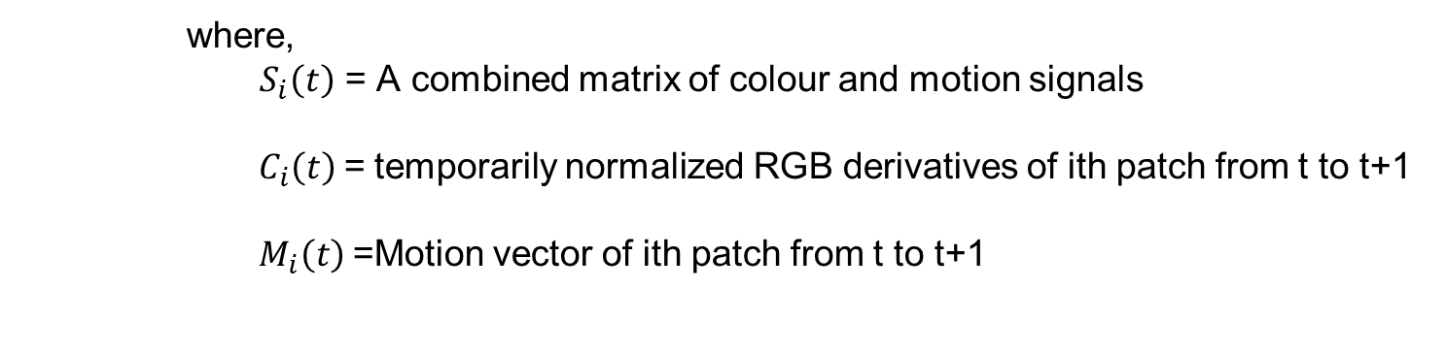
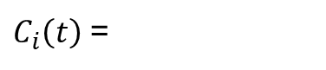
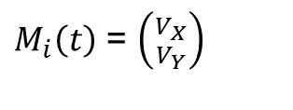
Methodology
Generation of RGB and motion derivatives
Based on segmented image patches , local color and motion signals are extracted
$S_{i}\left(t\right)$ = $\left({C_{i}\left(t\right) \atop M_{i}\left(t\right)}\right)$
where,
${ S}_{i}\left(t\right)$ = A combined matrix of colour and motion signals
$C_{i}\left(t\right)$= temporarily normalized RGB derivatives of ith patch from t to t+1
$M_{i}\left(t\right)$=Motion vector of ith patch from t to t+1
For each patch i, compute the color intensity changes between consecutive frames, this involves calculating the temporal derivatives of the RGB values to capture the changes over time
Motion vector is calculated by applying least-square regression between spatial(variation in pixel values) and temporal(change in pixel intensity over time) gradient
For PPG extraction we used DIS method which requires the RGB and motion signals as input
$C_{i}\left(t\right)$ =
$M_{i}\left(t\right)$ = $\left({V_{X} \atop V_{Y}}\right)$

Slide 8
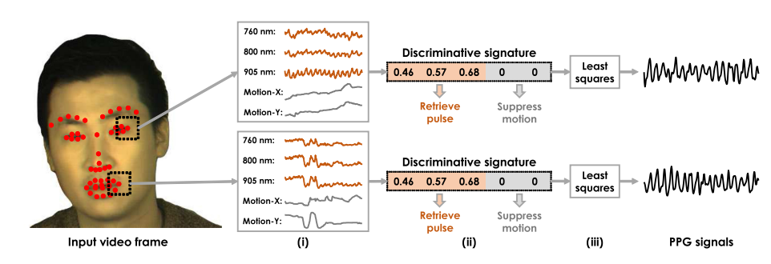
Methodology
Distance image signature method (DIS)
Fig 3:Steps of DIS method

Slide 9

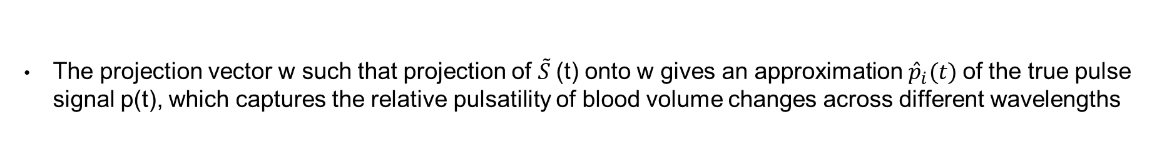
Methodology
Accumulation and filtering
Since, both RGB signals and motion signals are derivatives (where the colour and relative position changes)
are accumulated and summated to generate time signals
$${{\tilde{S}}_{i}}^{t→t+l}=1+\sum_{0}^{l}{{S_{i}}^{t→t+l}}$$
The accumulated signal is sent through a butter worth band-pass filter with cut-off 0.3-4Hz to eliminate the
out-band distortions
The projection vector w such that projection of $\tilde{S}$(t) onto w gives an approximation ${\hat{p}}_{i}(t)$of the true pulse signal p(t), which captures the relative pulsatility of blood volume changes across different wavelengths
PPG extraction
${\hat{p}}_{i}(t) =w.$ ${{\tilde{S}}_{i}(t)}^{T}∝p_{i}(t)$
$w =(p.$ ${\tilde{S}}^{T}) . {(\tilde{S}.{\tilde{S}}^{T}\text{)}}^{−1}$

Slide 10
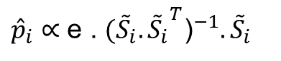
Methodology
The PPG signal is extracted by least squares fitting of the DIS method using the BVP signature(e)
e=quantifies the colour channels affected by blood pulsation
Both the motion and colour signals which are not along the BVP signature will be suppressed
${\hat{p}}_{i}∝$ e . ${({\tilde{S}}_{i}.{{\tilde{S}}_{i}}^{T}\text{)}}^{−1}.{\tilde{S}}_{i}$
Bandpass filtering
An adaptive band-pass filtering adjusts the heart rate in range [HR-25,HR+25] bpm based on maximum spectrum peak to improve signal quality
Selects patches which have highest SNR from the heatmap, and combine them to form a global PPG signal

Slide 11
Methodology
Camera based Respiratory extraction
Respiratory motion signals are extracted using pixflow algorithm as vertical movement contain strong respiration of the patient with respect to the camera angle and position of patient
The chest RoI is selected based on the face detection which is done using Mediapipe ( the area below the face) and helps in selecting respiratory signals
The local respiratory signals selected by SNR are combined into global respiratory signal

Slide 12
Algorithm
Input: Video sequence
Module 1: generate local colour and motion signals
- Multi-scale dense segmentation of the image
-Temporarily normalized colour and motion derivatives: S
-Temporal concatenation and cumulative summation
Module 2: generate local PPG and respiratory signals
-Bandpass filter the cumsum signal and extract PPG with DIS
-select Y direction of motion signal as respiration
Module 3:select cardio-respiratory RoI
-Generate PPG and respiratory heatmaps using SNR
-Face RoI detection by deep learning
-Face-guided living-skin and respiratory RoI selection
-Global signal generation and HR/BR calculation
Output: HR and BR

Slide 13
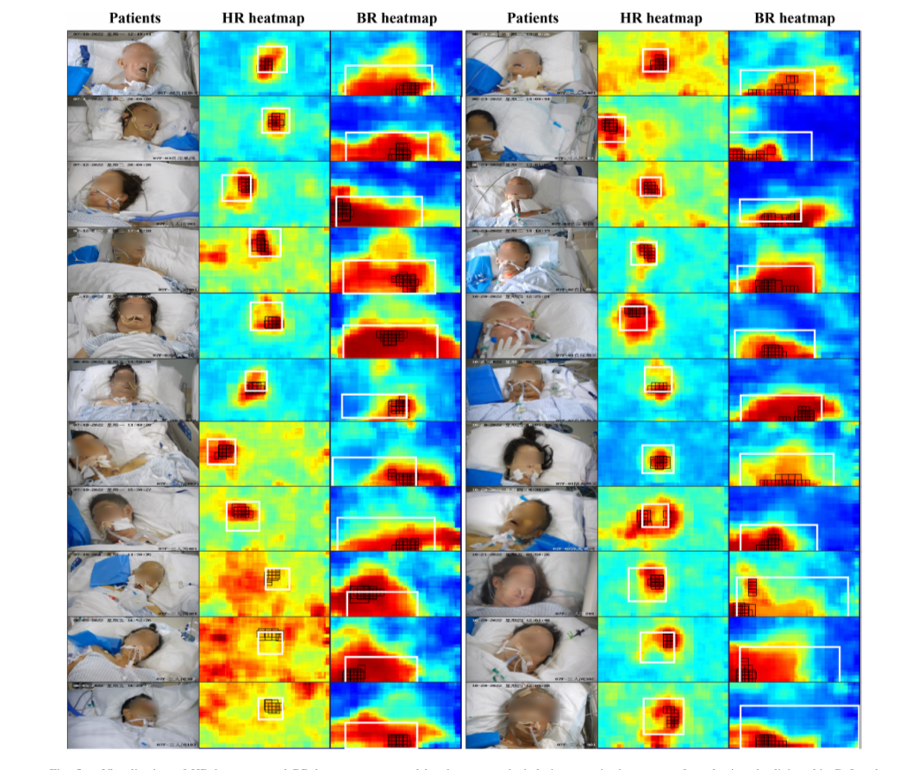
Methodology
SNR=signal power/noise power
Heatmap is used for selecting the living-skin RoI and respiratory RoI for HR and BR estimation
The red area mentions that high pulsatility rate and high breathing rate in HR and BR heatmap.
Fig 4: Heatmap of patients

Slide 14
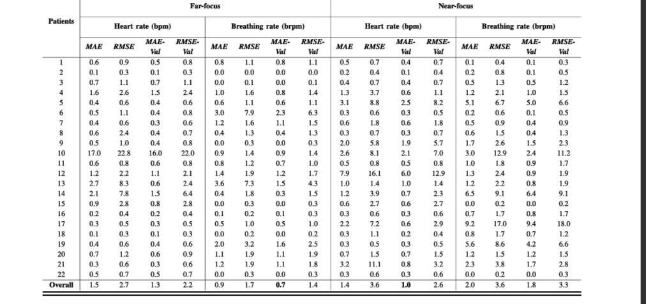
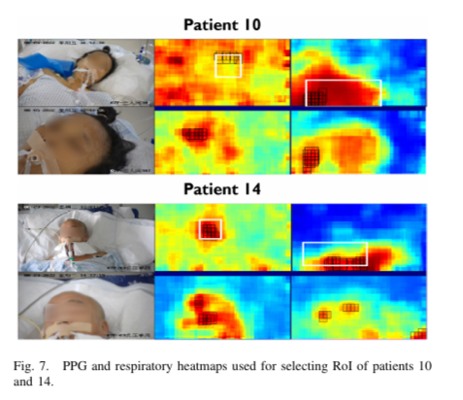
Result and Evaluation
MAE and RMSE are the quality metrics to evaluate HR and BR.
If the motion intensity is above the threshold then the respective HR and BR values will be removed.
The far-focus mode is better for measuring respiratory signals and near-focus mode is better for measuring breathing signals.
Table 1: Summary of vital signs monitoring for created ICU dataset

Slide 15
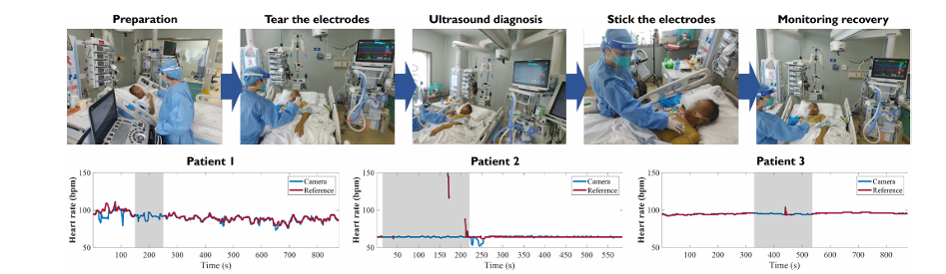
Result and Evaluation
Monitoring of patient while ultrasound diagnosis treatment
In this process, the HR of the second and third patients were consistent with the reference, while the first patient showed slight fluctuations before diagnosis.
In the absence of the reference values (period denoted in grey colour),the measurement curves of camera maintained consistent and well reflected the physiological conditions.
Fig 5: Three patients under ultrasound diagnosis

Slide 16
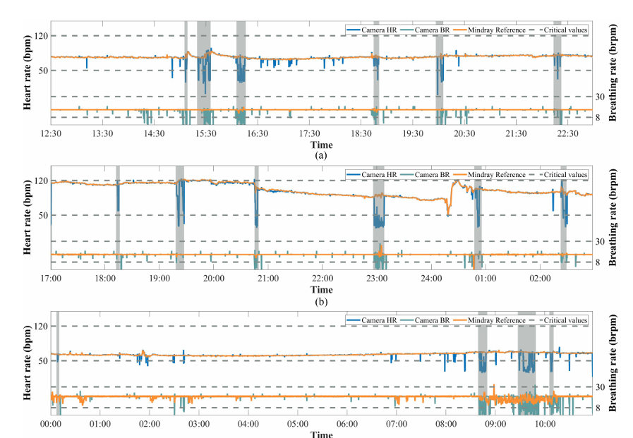
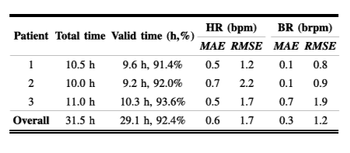
Result and Evaluation
Based on earlier studies and consultancy of clinicians, critical signs were defines as 50<BR<120 and 8<BR<30
During the long-term monitoring, the grey area denotes the time period in the video when monitoring was interfered by nurse operations(see Fig 6)
For overall obtained results, MAE for HR is 0.6bpm, for BR is 0.3brpm and the results are within the clinically acceptable range
(see Fig 5)
Fig 6: Vital sign monitoring for long-term recording
Fig 7: Results of longtime monitoring around 10 hour

Slide 17
CONCLUSION
The system can detect fundamental vital signs from the patients in ICU and alarm clinicians when detecting abnormal vital signs , including the night time using NIR(near infrared rays) efficiently
The clinical trial verified that the far-focus mode is suitable for respiratory monitoring while near-focus mode is suitable for heart-rate monitoring
The system has also shown the feasibility of long-term monitoring for ICU patients
In future research, the system can be extended to include a wider range of physiological parameters . And, higher frame rate camera can be used to read detailed physiological changes

Slide 18
Progress – Gantt Chart
S. No. | Title of the project | Project Objective | Work progress Till date | Manuscript status | Publication submission | Accepted/ Under review
1 | Physiological monitoring using CCTV camera in ICU | Monitoring of patient in ICU using CCTV camera in the absence of nurse and contact based monitoring | -The image resolution is reduced using binning process. -Then the resolved image has been segmented into subregions by local blocks. -Normalized the color image and generated motion signals -Generated PPG signal using DIS method -Generated PPG signal for gray scale image using DIS method | - | - | -
2

Slide 19

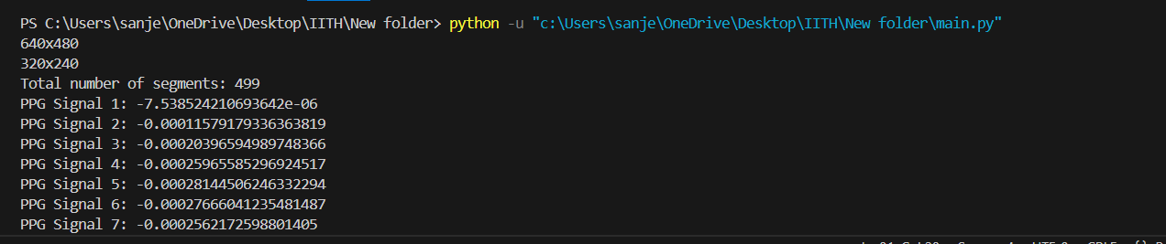
Result
The image is extracted from the camera and the image is binned and reduced the image resolution to reduce the noises and increase the efficiency of signal (see Fig 7)
Total 499 Image patches are extracted after segmentation process and PPG signal is calculated only by using the colour signals and the motion vector
Fig 9: Total number of patches and ppg signal(amplitude) value for every patches.
Fig 8: Binned image after reduced resolution

Slide 20
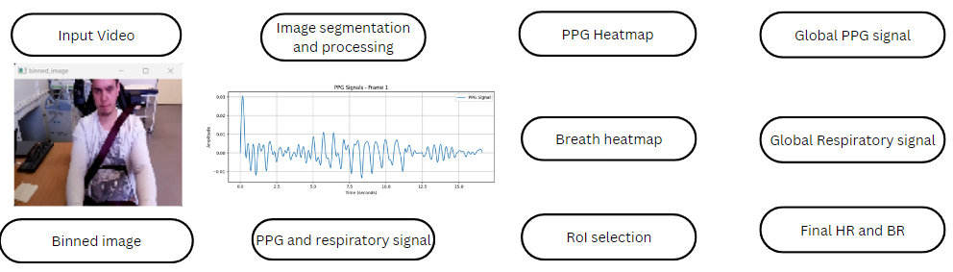
Result
The frames are extracted and image is extracted from the camera and the image is binned and reduced the image resolution to reduce the noises and increase the efficiency of signal (see Fig 10)
Image patches are extracted after segmentation process and PPG signal is calculated by using the colour signals and the motion vector(see Fig 10)
Fig 10: Pipeline of the workflow

Slide 21
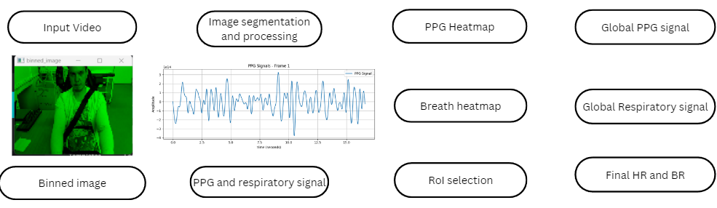
RESULT
The frames are extracted and image is converted to grey scale and the image is binned and reduced the image resolution to reduce the noises and increase the efficiency of signal (see Fig 10)
Image patches are extracted after segmentation process and PPG signal is calculated by using the colour signals and the motion vector(see Fig 11)
Fig 11: Pipeline of the workflow for grey scale image

Slide 22
THANK YOU
18.06.2024
VIKASH PR
22

